Slide 1
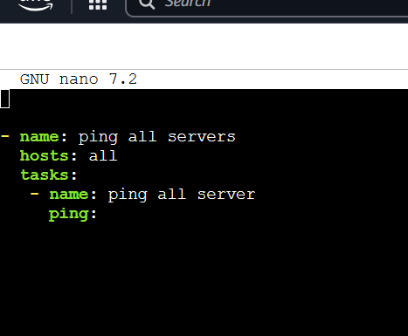
Create your first Ansible playbook
Playbook file with yaml code
- name: ping all servers
hosts: all
tasks:
- name: ping all server
ping:

Slide 2
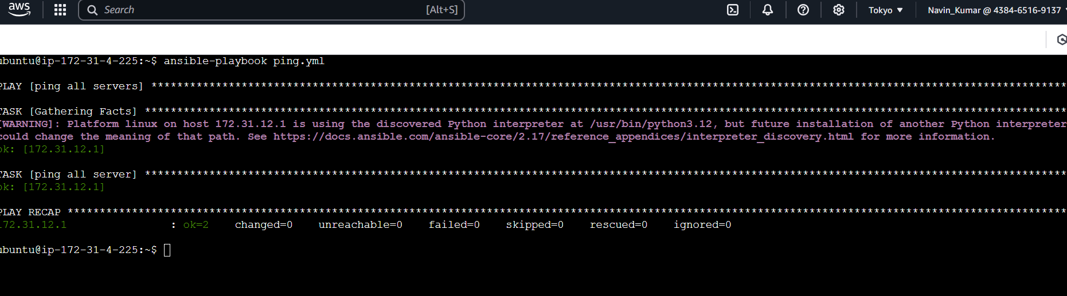
Create your first Ansible playbook

